Slide 1


Slide 2
Meet the Team
Hector

Slide 3
Meet the Team
David

Slide 4
Meet the Team
Vladimir

Slide 5
Meet the Team
Kian Farley
Computer Science and Mathematics Major
Database Management and Back End Team

Slide 6
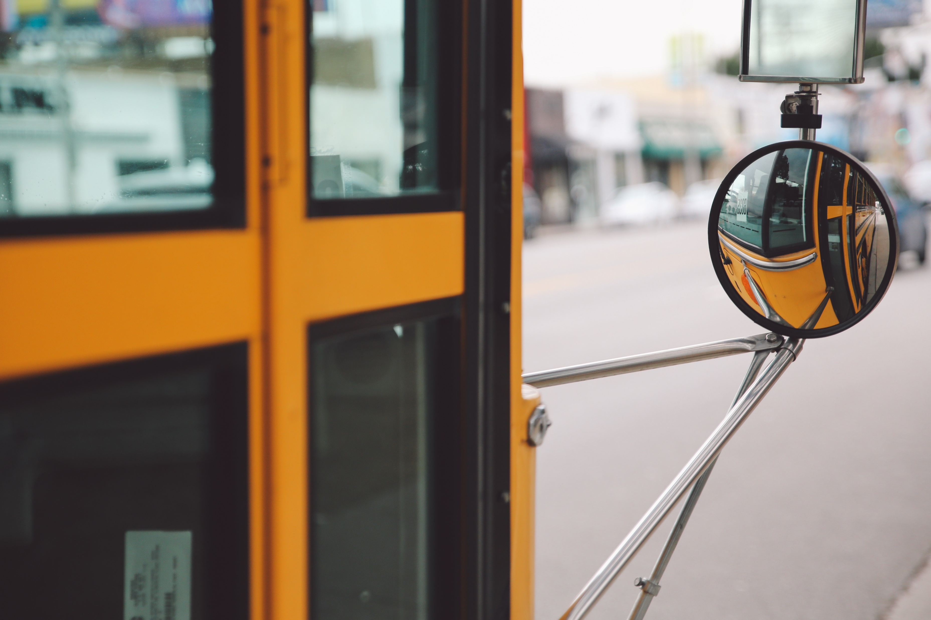
Problem
The current school bus system is outdated
Kids often have to stand outside in the cold
Don’t know if the bus is on time
No way to update parents quickly

Slide 7
Solution

